Slide 1
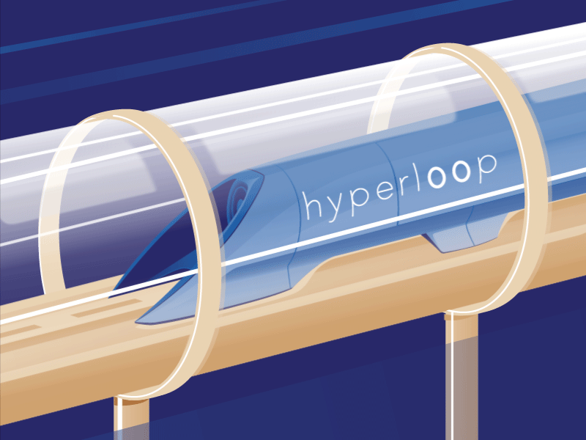
HYPERLOOP the fifth form of transportation
• Kashish
• CEB1
• 2314120

Slide 2
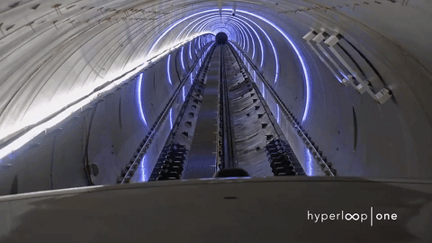
INTRODUCTION
• Hyperloop is a proposed high-speed transportation system for both passengers and freight.
• The idea was popularized by Elon Musk in his 2013, envisioning a new mode of transport that could revolutionize long-distance travel.
• The system relies on magnetic levitation (maglev) and air pressure to minimize friction and allow for rapid acceleration and deceleration.

Slide 3
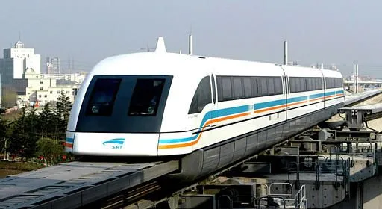
Magnetic levitation
• Maglev (magnetic levitation) is a system of rail transport whose rolling stock is levitated by electromagnets rather than rolled on wheels, eliminating rolling resistance.
• Magnetic levitation (maglev) is a method by which an object is suspended with no support other than magnetic fields.

Slide 4
Eds & ems
Different maglev systems achieve levitation in different ways, which broadly fall into two categories: electromagnetic suspension (EMS) and electrodynamic suspension (EDS).
• Electromagnetic Suspension (EMS):- EMS uses the attractive force between magnets present on the train’s sides , underside and on the guideway to levitate the train. It achieve high speed up to 1600 km per hr.
• Electrodynamic Suspension (EDS) :- This system are similar to EMS in several respects, but the magnets are used to repel the train from the guideway rather than attract them.

Slide 5
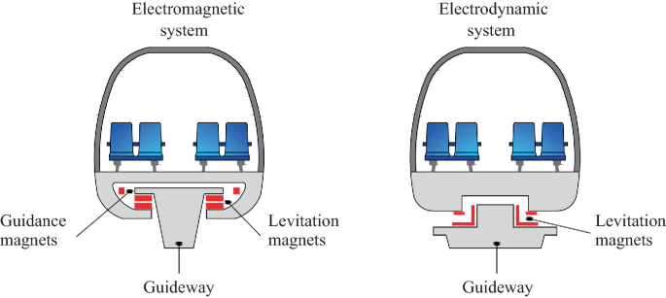

Slide 6
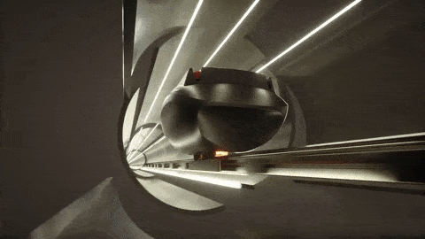
Working principle of hyperloop
• The Hyperloop operates in a low-pressure environment within sealed tubes .
• Passenger or cargo pods are designed to be aerodynamic, minimizing drag as they travel through the tubes.
• The pods use magnetic levitation technology, either through EMS or EDS, to float above the track, eliminating friction and enabling smooth travel.
• The combination of low air resistance, magnetic levitation, and linear propulsion can enable speeds of over 700 miles per hour.

Slide 7
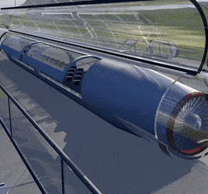
Components
Pods
2. Tube
3. Propulsion

Slide 8
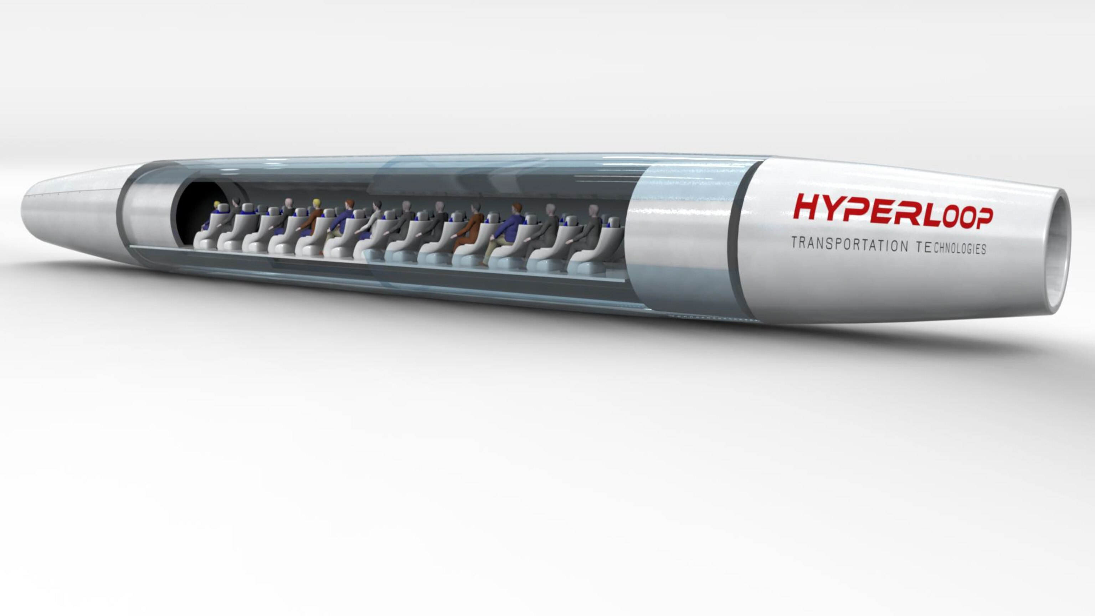
pods
• Capsule-Like Design.
• Utilize magnetic levitation to float above the track, eliminating friction.
• Capable of reaching speeds over 700 miles per hour.
• Equipped with comfortable seating and safety features for passengers.

Slide 9
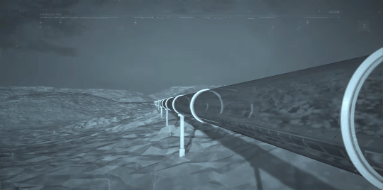
tube
•The tube is made of steel and high strength glass fibre.
• The tube is designed to maintain a low-pressure environment, reducing air resistance .
• The tubes are often envisioned to be straight and elevated, minimizing land use and enabling higher speeds.

Slide 10
propulsion
• Utilizes electromagnetic systems to create thrust, allowing for efficient acceleration.
• It Helps lift the pod off the track, reducing friction and enhancing smooth movement.
• It also allows pods to maintain high speeds with minimal energy consumption.
• By Reducing air resistance, making propulsion more efficient and requiring less energy.

Slide 11
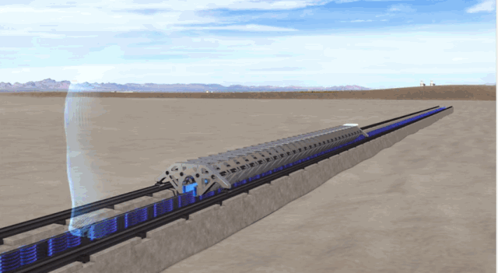

Slide 12
advantages
► Capable of traveling at speeds of up to 700 miles per hour, significantly reducing travel time between cities.
► Potentially lower maintenance costs compared to high-speed rail, as it built above the ground and requires less land.
► Provides a smooth ride with minimal vibration and noise due to the levitation and low-pressure design.
► Enclosed pods in a controlled environment reduce the risks of accidents, weather disruptions, and pollution.

Slide 13
DRawbacks
► Its initial cost is very high.
►Maintaining a low-pressure environment poses challenges, particularly in terms of engineering and passenger comfort.
► It may be most effective for medium-distance travel, potentially less suitable for very short or long trips.
► It has limited space in the train and hence people can not move freely.

Slide 14
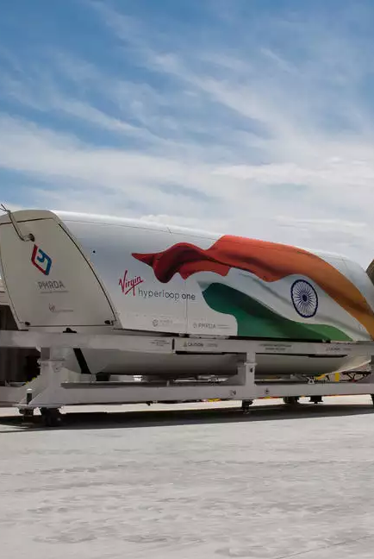
Hyperloop in india
Hyperloop in India is expected to be launched soon!... In the month of February 2018 , chairman of ‘virgin hyperloop one’, Richard Branson had announced plans of launching the Mumbai-Pune hyperloop project , the travel time using the hyperloop speed is said to reduce from 3 hours to just 35 minutes. However , those plans have stalled due to covid-19 pandemic.

Slide 15
LIST OF REFERENCES
•About hyperloop :- https://en.wikipedia.org/wiki/Hyperloop
• Working principle :- https://www.ijert.org/hyperloop-the-new-transport-system
• Magnetic levitation concept;-https://www.britannica.com/technology/maglev-train
•Hyperloop picture-https://www.google.com/url?sa=i&url=https%3A%2F%2Fimgur.com%2Fgallery%2Fhyperloop-aoxEduA&psig=AOvVaw3F9kRhW_p2JvTCNTiaDbWY&ust=1730651623987000&source=images&cd=vfe&opi=89978449&ved=0CBEQjhxqFwoTCIiRxdWxv4kDFQAAAAAdAAAAABAE
• Hyperloop in India ;- https://www.financialexpress.com/business/infrastructure/indias-1st-hyperloop-project-travel-between-mumbai-and-pune-in-just-25-mins-key-details-of-unique-project/1753602/
• Chatgpt .

Slide 16


